Slide 1
Brain Computer Interaction
Feature Translation
Course Instructors
Dr. Annushree Bablani
Acknowledgements: Dr. Sreeja S R

Slide 2
THIRD STEP: FEATURE CONDITIONING
The distributions and the relationships among the features can have a significant effect on the performance of the translation algorithm that follows feature extraction. These effects depend on the characteristics of the particular translation algorithm.
NORMALIZATION
LOG-NORMAL TRANSFORMS
FEATURE SMOOTHING
PCA AND ICA
Removing irrelevant and redundant features (MRMR-Maximum Relevant Minimum Redundant)

Slide 3
Feature Translation
Discriminant functions
Regression functions

Slide 4
Illustrating Classification Tasks

Slide 5
Regression Analysis
The regression analysis is a statistical method to deal with the formulation of mathematical model depicting relationship amongst variables, which can be used for the purpose of prediction of the values of dependent variable, given the values of independent variables.
Classification of Regression Analysis Models
Linear regression models
Simple linear regression
Multiple linear regression
Non-linear regression models

Slide 6
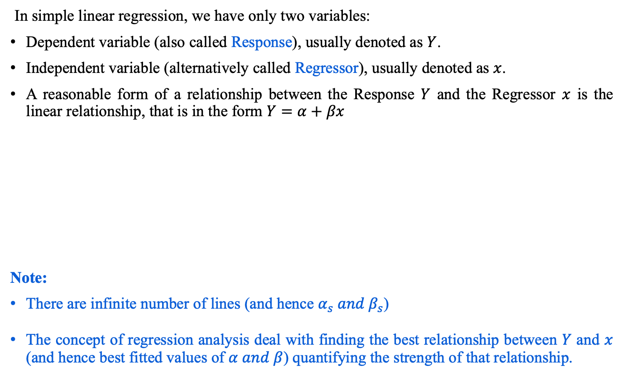
Simple Linear Regression Model
In simple linear regression, we have only two variables:
Dependent variable (also called Response), usually denoted as $Y$.
Independent variable (alternatively called Regressor), usually denoted as $x$.
A reasonable form of a relationship between the Response $Y$ and the Regressor $x$ is the linear relationship, that is in the form $Y=α+βx$
Note:
There are infinite number of lines (and hence $α_{s} and β_{s}$)
The concept of regression analysis deal with finding the best relationship between $Y$ and $x$ (and hence best fitted values of $α and β$) quantifying the strength of that relationship.

Slide 7
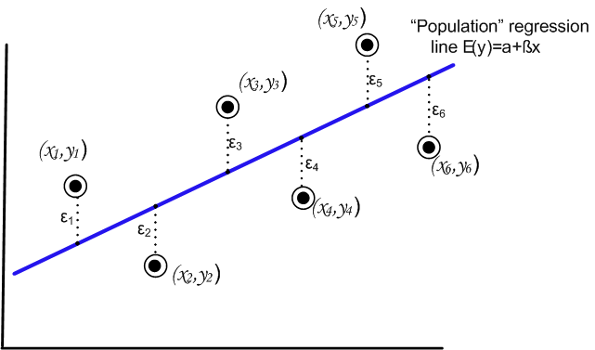
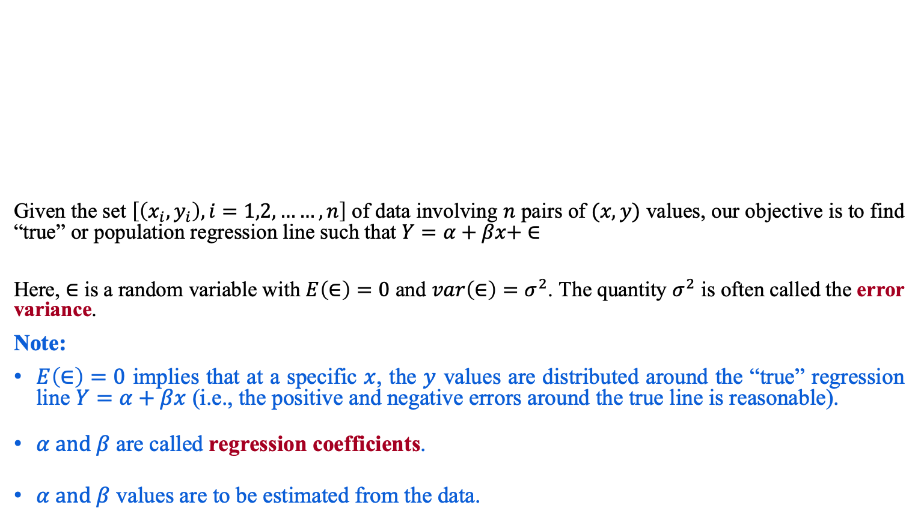
Regression Analysis
Given the set $\left[\left(x_{i},y_{i}\right), i=1,2,……,n\right]$ of data involving $n$ pairs of $(x,y)$ values, our objective is to find “true” or population regression line such that $Y=α+βx+ ∈$
Here, $∈$ is a random variable with $E\left(∈\right)=0$ and $var\left(∈\right)=σ^{2}$. The quantity $σ^{2}$ is often called the error variance.
Note:
$E\left(∈\right)=0$ implies that at a specific $x$, the $y$ values are distributed around the “true” regression line $Y=α+βx$ (i.e., the positive and negative errors around the true line is reasonable).
$α and β$ are called regression coefficients.
$α and β$ values are to be estimated from the data.

Slide 8
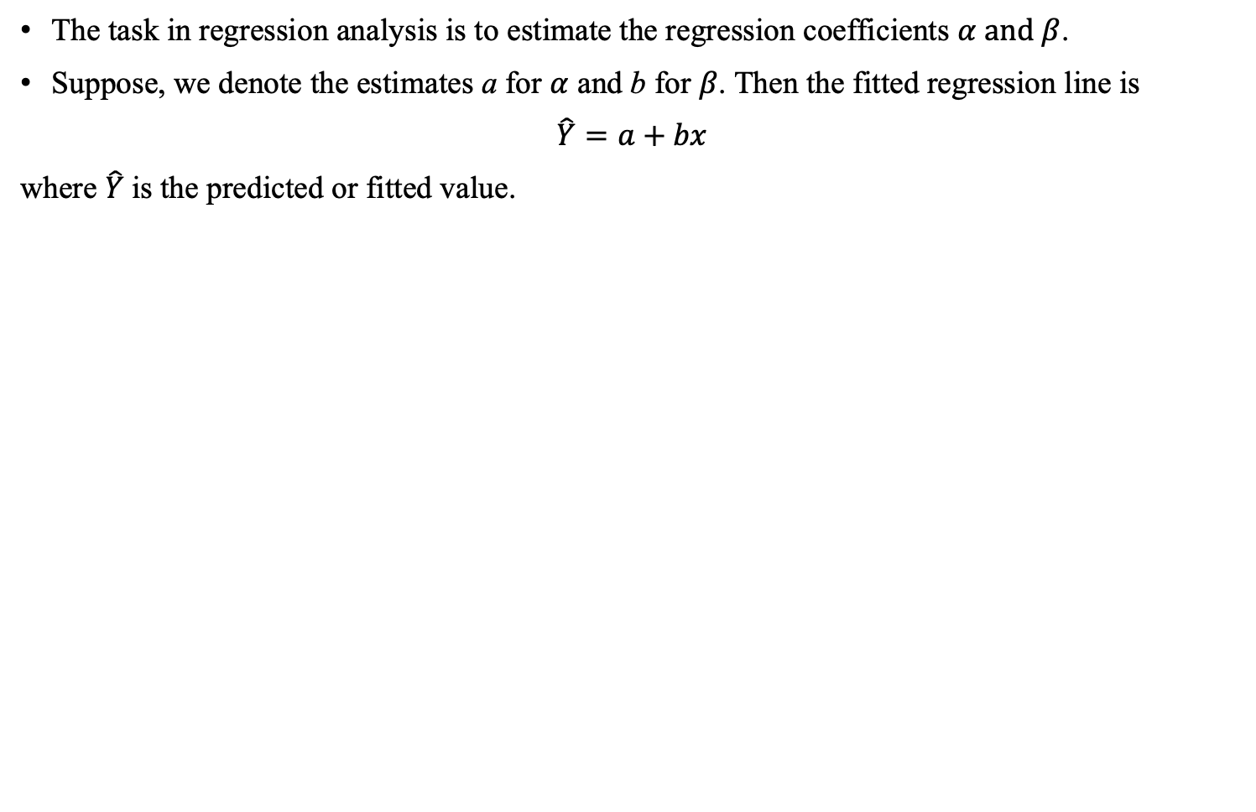
True versus Fitted Regression Line
The task in regression analysis is to estimate the regression coefficients $α and β$.
Suppose, we denote the estimates a for $α$ and b for $β$. Then the fitted regression line is
$\hat{Y}=a+bx$
where $\hat{Y}$is the predicted or fitted value.

Slide 9
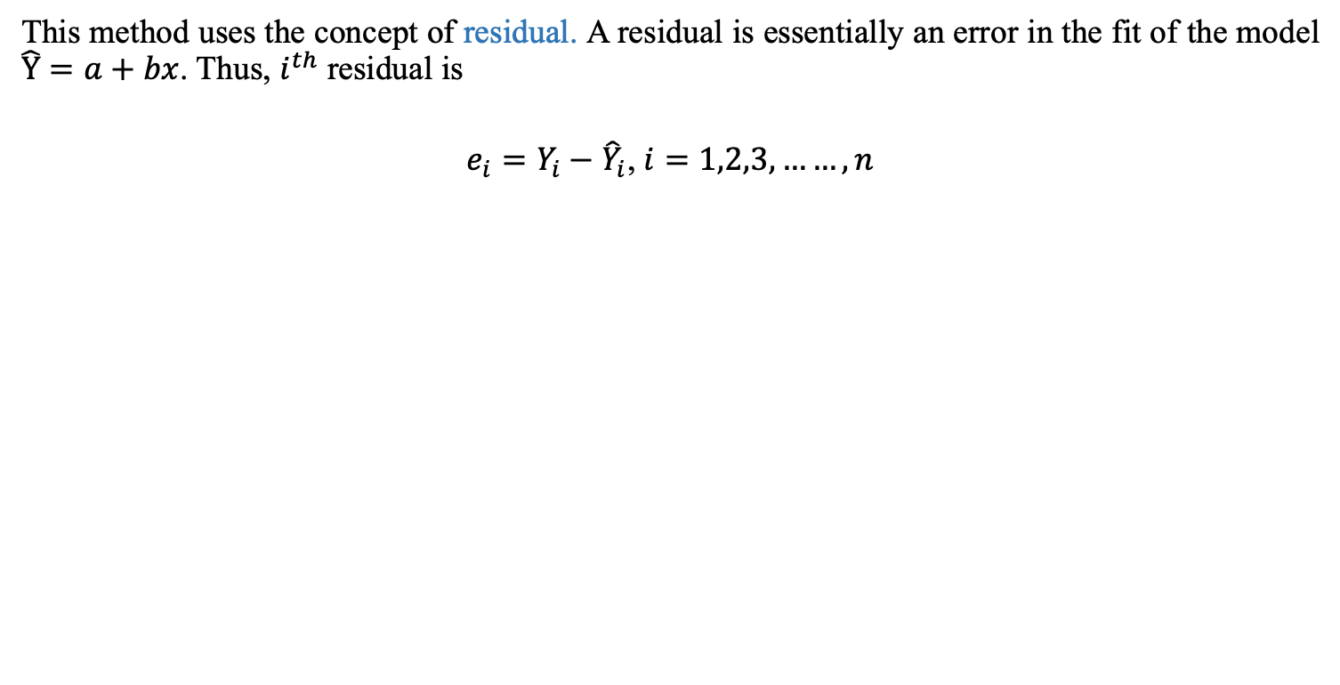
Least Square Method to estimate $α and β$
This method uses the concept of residual. A residual is essentially an error in the fit of the model $\hat{Y}=a+bx$. Thus, $i^{th}$ residual is
$e_{i}=Y_{i}−{\hat{Y}}_{i}$, $i=1,2,3,……,n$

Slide 10
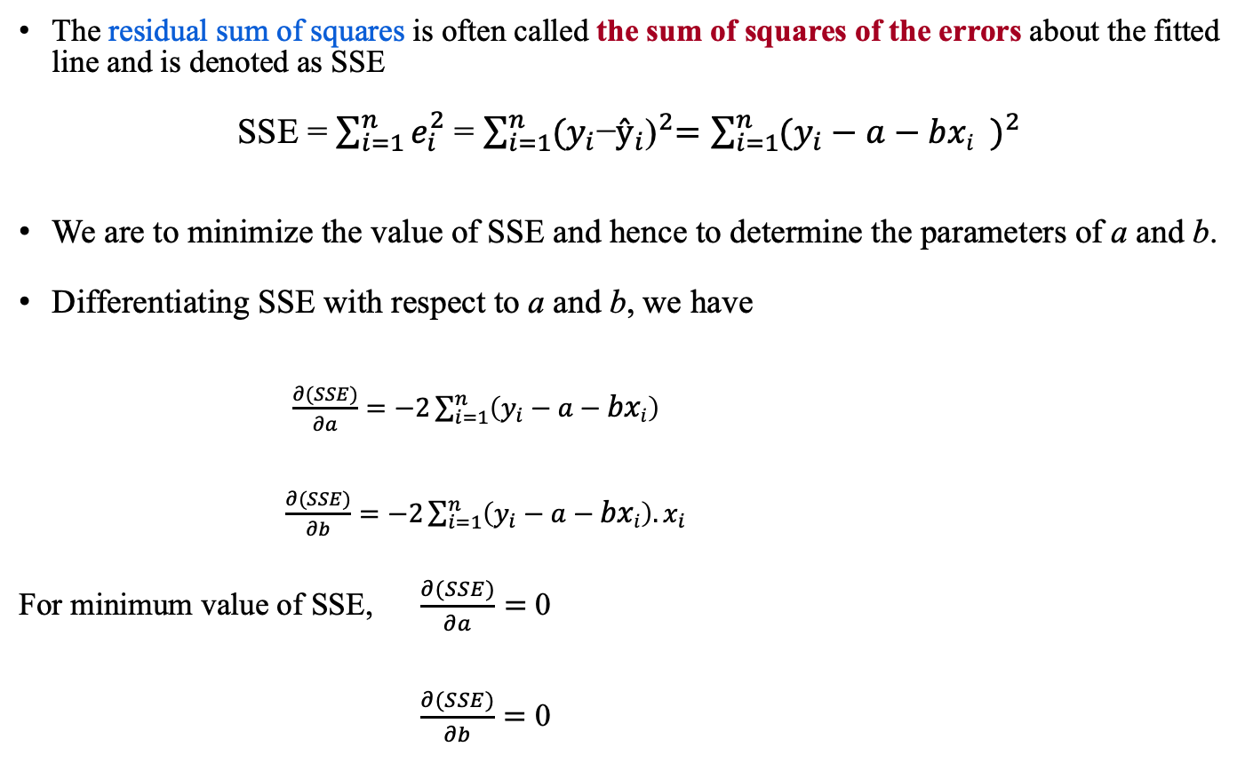
Least Square method
The residual sum of squares is often called the sum of squares of the errors about the fitted line and is denoted as SSE
SSE = $\sum_{i=1}^{n}{e_{i}^{2}}$ = $\sum_{i=1}^{n}{{(y_{i}\text{−}ŷ_{i}\text{)}}^{2}=\sum_{i=1}^{n}{{(y_{i}−a−{bxi}_{})}^{2}}}$
We are to minimize the value of SSE and hence to determine the parameters of a and b.
Differentiating SSE with respect to a and b, we have
$\frac{∂(SSE)}{∂a}=−2\sum_{i=1}^{n}{{\left(y_{i}−a−bxi\right)}^{}}$
$\frac{∂(SSE)}{∂b}=−2\sum_{i=1}^{n}{\left(y_{i}−a−bxi\right).x_{i}}$
For minimum value of SSE, $\frac{∂(SSE)}{∂a}=$ 0
$\frac{∂(SSE)}{∂b}=$ 0

Slide 11
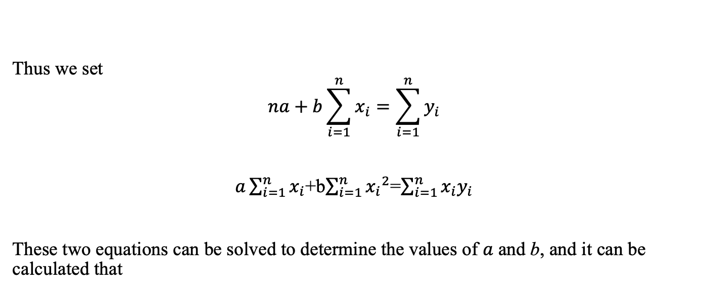
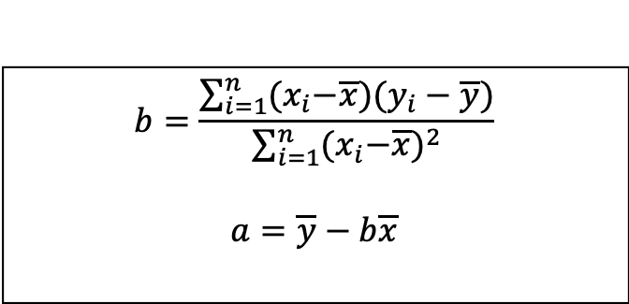
Least Square method to estimate $α and β$
Thus we set
$$na+b\sum_{i=1}^{n}{x_{i}}=\sum_{i=1}^{n}{y_{i}}$$
$a\sum_{i=1}^{n}{x_{i}}$+b$\sum_{i=1}^{n}{{x_{i}}^{2}}$=$\sum_{i=1}^{n}{x_{i}y_{i}}$
These two equations can be solved to determine the values of $a$ and b, and it can be calculated that
$$b=\frac{\sum_{i=1}^{n}{{(x}_{i}−\overline{x}{)(y}_{i}−\overline{y})}}{\sum_{i=1}^{n}{{{(x}_{i}−\overline{x})}^{2}}}$$
$$a=\overline{y}−b\overline{x}$$

Slide 12
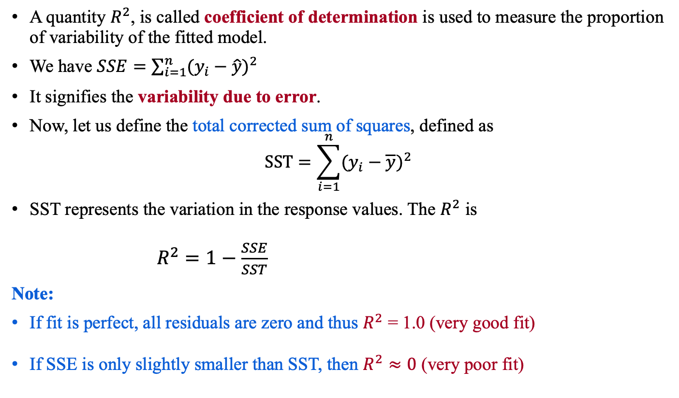
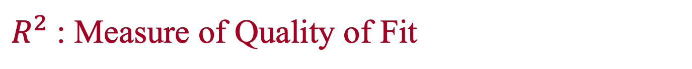
$R^{2}$: Measure of Quality of Fit
A quantity $R^{2}$, is called coefficient of determination is used to measure the proportion of variability of the fitted model.
We have $SSE=\sum_{i=1}^{n}{{(y_{i}−\hat{y})}^{2}}$
It signifies the variability due to error.
Now, let us define the total corrected sum of squares, defined as
$$SST=\sum_{i=1}^{n}{{(y_{i}−\overline{y})}^{2}}$$
SST represents the variation in the response values. The $R^{2}$ is
$R^{2}=1−\frac{SSE}{SST}$
Note:
If fit is perfect, all residuals are zero and thus $R^{2}$ = 1.0 (very good fit)
If SSE is only slightly smaller than SST, then $R^{2}≈0$ (very poor fit)

Slide 13
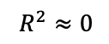
$R^{2}$: Measure of Quality of Fit
$$R^{2}≈0$$

Slide 14
Bayesian Classifier

Slide 15
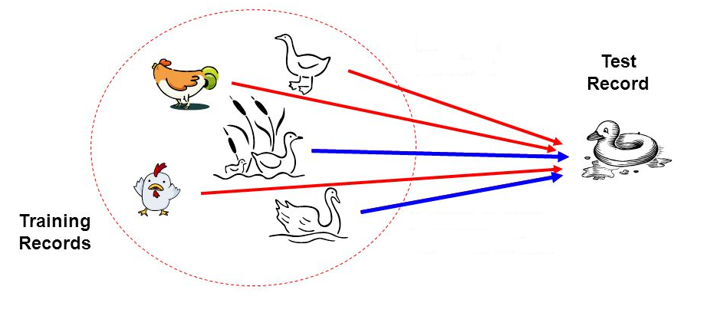
Bayesian Classifier
Principle
If it walks like a duck, quacks like a duck, then it is probably a duck

Slide 16
Bayesian Classifier
A statistical classifier
Performs probabilistic prediction, i.e., predicts class membership probabilities
Foundation
Based on Bayes’ Theorem.
Assumptions
The classes are mutually exclusive and exhaustive.
The attributes are independent given the class.
Called “Naïve” classifier because of these assumptions.
Empirically proven to be useful.
Scales very well.

Slide 17

Example: Bayesian Classification
Example 8.2: Air Traffic Data
Let us consider a set observation recorded in a database
Regarding the arrival of airplanes in the routes from any airport to New Delhi under certain conditions.

Slide 18
Air-Traffic Data
Days | Season | Fog | Rain | Class
Weekday | Spring | None | None | On Time
Weekday | Winter | None | Slight | On Time
Weekday | Winter | None | None | On Time
Holiday | Winter | High | Slight | Late
Saturday | Summer | Normal | None | On Time
Weekday | Autumn | Normal | None | Very Late
Holiday | Summer | High | Slight | On Time
Sunday | Summer | Normal | None | On Time
Weekday | Winter | High | Heavy | Very Late
Weekday | Summer | None | Slight | On Time
Cond. to next slide…

Slide 19
Air-Traffic Data
Cond. from previous slide…
Days | Season | Fog | Rain | Class
Saturday | Spring | High | Heavy | Cancelled
Weekday | Summer | High | Slight | On Time
Weekday | Winter | Normal | None | Late
Weekday | Summer | High | None | On Time
Weekday | Winter | Normal | Heavy | Very Late
Saturday | Autumn | High | Slight | On Time
Weekday | Autumn | None | Heavy | On Time
Holiday | Spring | Normal | Slight | On Time
Weekday | Spring | Normal | None | On Time
Weekday | Spring | Normal | Heavy | On Time

Slide 20
Air-Traffic Data
In this database, there are four attributes
A = [ Day, Season, Fog, Rain]
with 20 tuples.
The categories of classes are:
C= [On Time, Late, Very Late, Cancelled]
Given this is the knowledge of data and classes, we are to find most likely classification for any other unseen instance, for example:
Classification technique eventually to map this tuple into an accurate class.
Week Day | Winter | High | None | ???

Slide 21
Bayesian Classifier
In many applications, the relationship between the attributes set and the class variable is non-deterministic.
In other words, a test cannot be classified to a class label with certainty.
In such a situation, the classification can be achieved probabilistically.
The Bayesian classifier is an approach for modelling probabilistic relationships between the attribute set and the class variable.
More precisely, Bayesian classifier use Bayes’ Theorem of Probability for classification.
Before going to discuss the Bayesian classifier, we should have a quick look at the Theory of Probability and then Bayes’ Theorem.

Slide 22
Bayes’ Theorem of Probability

Slide 23
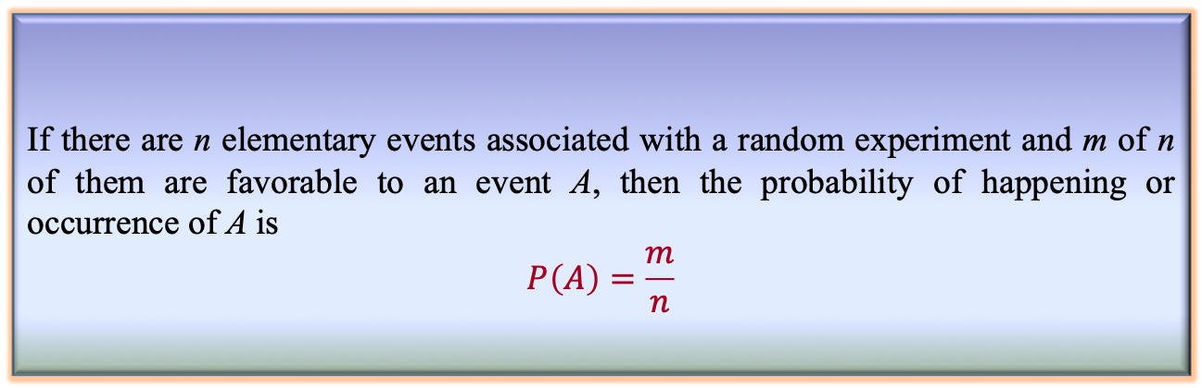
Simple Probability
Definition 8.2: Simple Probability
If there are n elementary events associated with a random experiment and m of n of them are favorable to an event A, then the probability of happening or occurrence of A is
$$P\left(A\right)=\frac{m}{n}$$

Slide 24

Simple Probability
Suppose, A and B are any two events and P(A), P(B) denote the probabilities that the events A and B will occur, respectively.
Mutually Exclusive Events:
Two events are mutually exclusive, if the occurrence of one precludes the occurrence of the other.
Example: Tossing a coin (two events)
Tossing a ludo cube (Six events)
Can you give an example, so that two events are not mutually exclusive?
Hint: Tossing two identical coins, Weather (sunny, foggy, warm)

Slide 25
Simple Probability
Independent events: Two events are independent if occurrences of one does not alter the occurrence of other.
Example: Tossing both coin and ludo cube together.
(How many events are here?)
Can you give an example, where an event is dependent on one or more other events(s)?
Hint: Receiving a message (A) through a communication channel (B)
over a computer (C), rain and train.

Slide 26
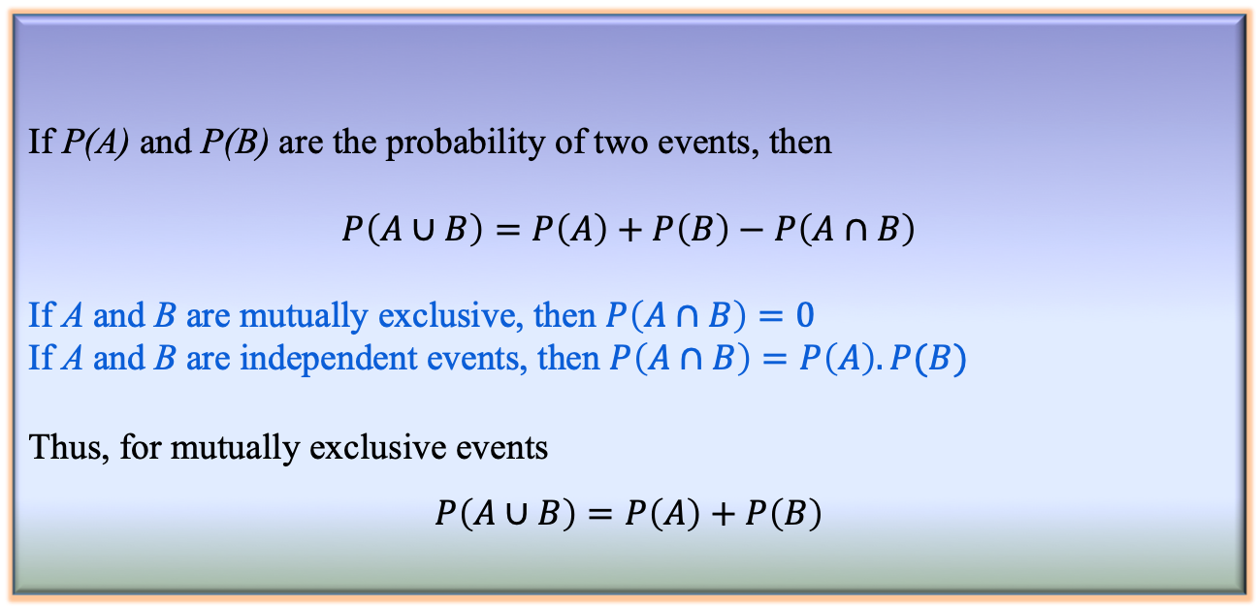
Joint Probability
Definition 8.3: Joint Probability
If P(A) and P(B) are the probability of two events, then
$$P\left(A∪B\right)=P\left(A\right)+P\left(B\right)−P\left(A∩B\right)$$
If A and B are mutually exclusive, then $P\left(A∩B\right)=0$
If A and B are independent events, then $P\left(A∩B\right)=P\left(A\right).P(B)$
Thus, for mutually exclusive events
$$P\left(A∪B\right)=P\left(A\right)+P\left(B\right)$$

Slide 27
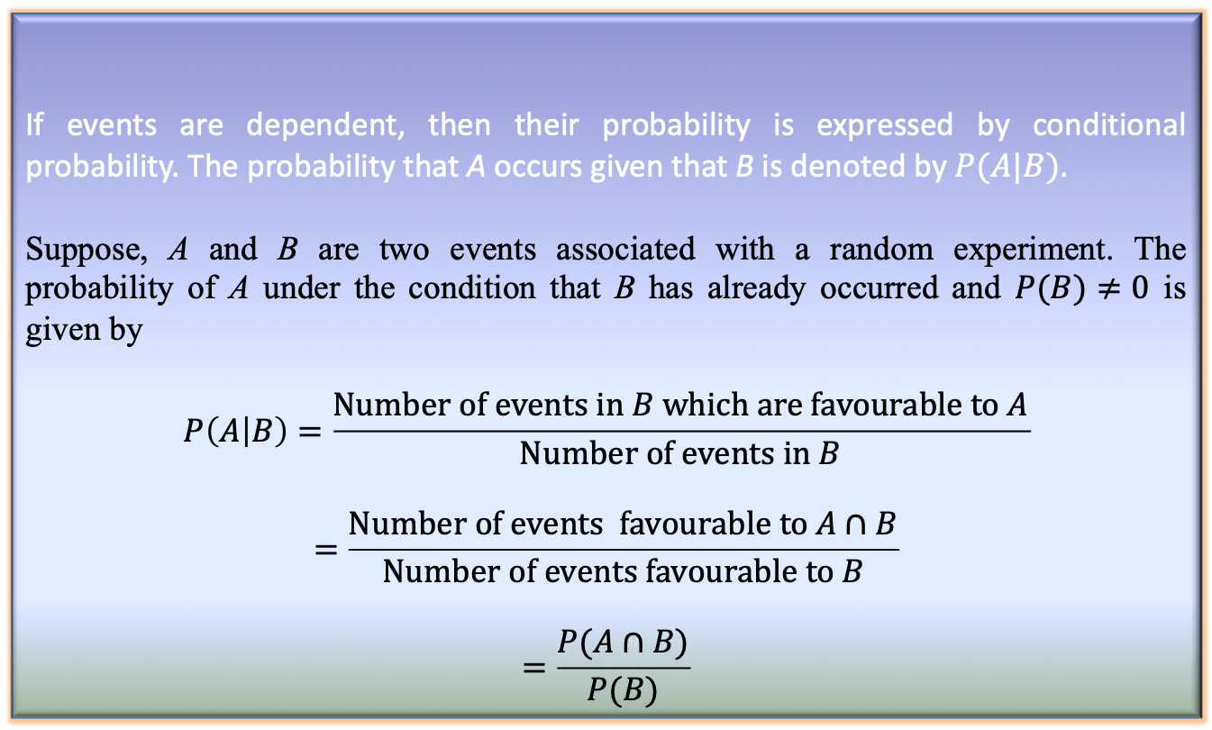
Conditional Probability
Definition 8.2: Conditional Probability
If events are dependent, then their probability is expressed by conditional probability. The probability that A occurs given that B is denoted by $P(A|B)$.
Suppose, A and B are two events associated with a random experiment. The probability of A under the condition that B has already occurred and $P(B)≠0$ is given by
$$P\left(A | B\right)=\frac{Number of events in B which are favourable to A}{Number of events in B}$$
$$=\frac{Number of events favourable to A∩B}{Number of events favourable to B}$$
$$=\frac{P(A∩B)}{P(B)}$$

Slide 28
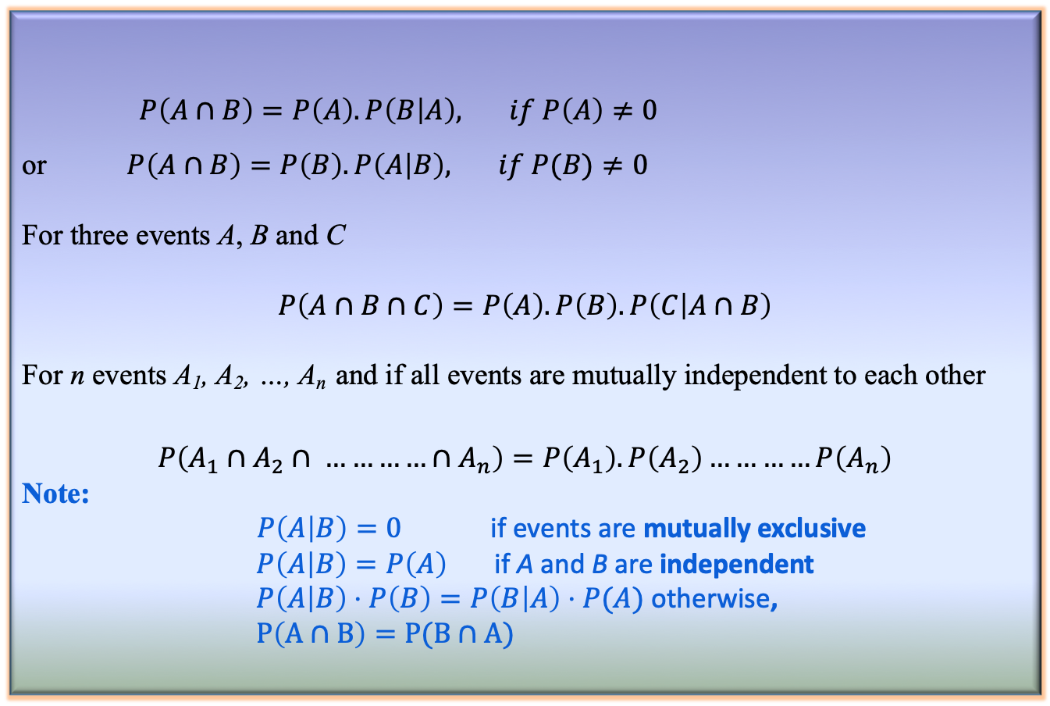
Conditional Probability
Corollary 8.1: Conditional Probability
$P\left(A∩B\right)=P\left(A\right).P\left(B | A\right), if P\left(A\right)≠0$
or $P\left(A∩B\right)=P\left(B\right).P\left(A | B\right), if P(B)≠0$
For three events A, B and C
$$P\left(A∩B∩C\right)=P\left(A\right).P\left(B\right).P\left(C | A∩B\right)$$
For n events A₁, A₂, …, A_{n} and if all events are mutually independent to each other
$$P\left(A_{1}∩A_{2}∩ …………∩A_{n}\right)=P\left(A_{1}\right).P\left(A_{2}\right)…………P\left(A_{n}\right)$$
Note:
$P\left(A | B\right)=0$ if events are mutually exclusive
$P\left(A | B\right)=P\left(A\right)$ if A and B are independent
$P\left(A | B\right)⋅P\left(B\right)=P\left(B | A\right)⋅P(A)$ otherwise,
$P\left(A∩B\right)=P(B∩A)$

Slide 29
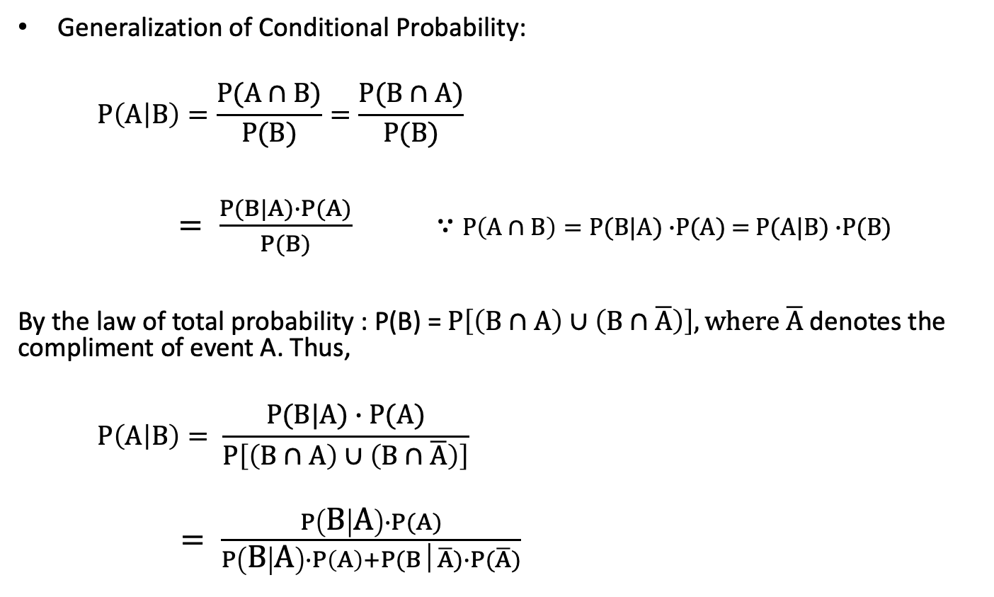
Conditional Probability
Generalization of Conditional Probability:
$$P\left(A | B\right)=\frac{P(A∩B)}{P(B)}=\frac{P(B∩A)}{P(B)}$$
$= \frac{P(B|A)∙P(A)}{P(B)}$ ∵ $P\left(A∩B\right)=P(B|A)$ $∙$P(A) = $P(A|B)$ $∙$P(B)
By the law of total probability : P(B) = $P\left[\left(B∩A\right)∪\left(B∩\overline{A}\right)\right],\text{where} \overline{A} \text{denotes} \text{the} \text{compliment} \text{of} \text{event} \text{A}\text{. }\text{Thus}\text{, }$
$$P\left(A | B\right)= \frac{P(B|A)∙P(A)}{P\left[\left(B∩A\right)∪\left(B∩\overline{A}\right)\right]}$$
$= \frac{P\left(B | A\right)∙P(A)}{P\left(B | A\right)∙P\left(A\right)+P(B│\overline{A})∙P(\overline{A})}$

Slide 30
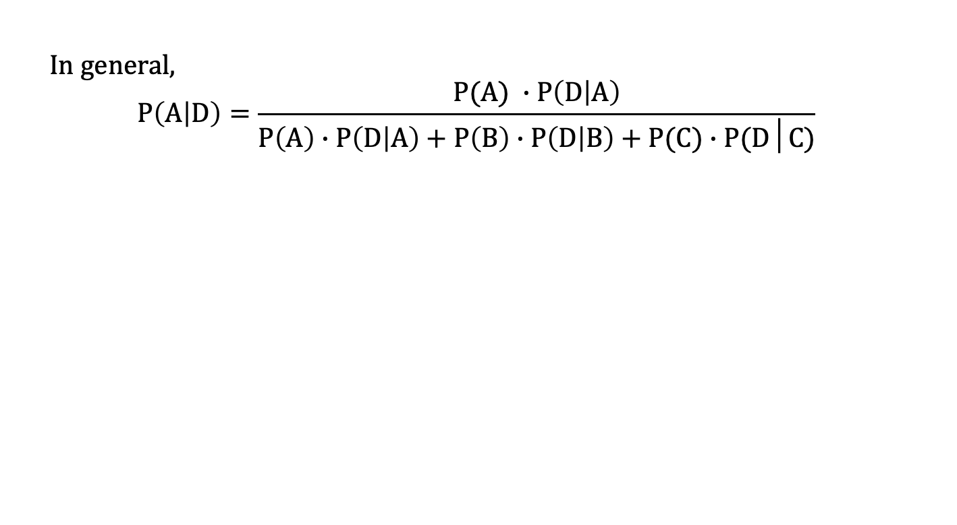
Conditional Probability
In general,
$$P\left(A | D\right)=\frac{P(A) ∙P\left(D | A\right)}{P\left(A\right)∙P\left(D | A\right)+P\left(B\right)∙P\left(D | B\right)+P(C)∙P(D│C)}$$

Slide 31
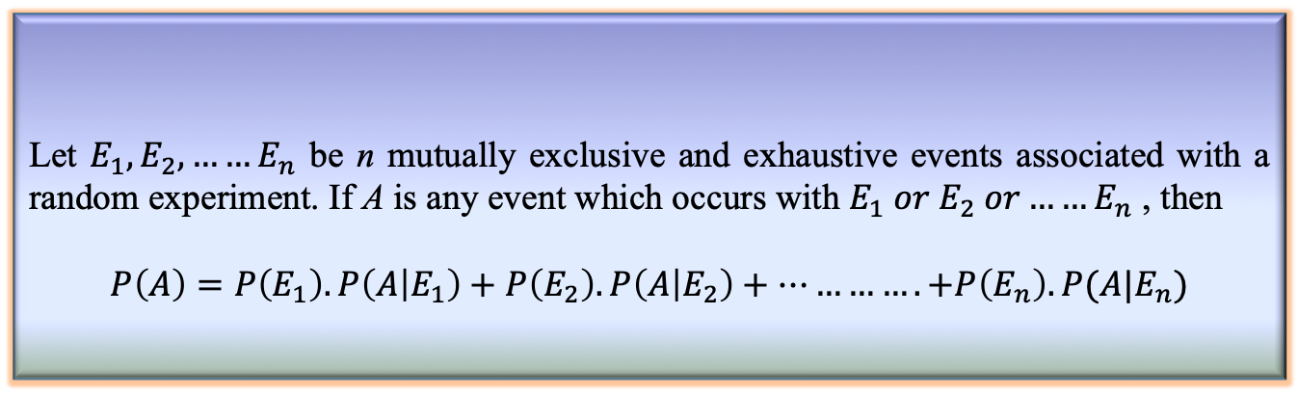
Total Probability
Definition 8.3: Total Probability
Let $E_{1},E_{2},……E_{n}$ be n mutually exclusive and exhaustive events associated with a random experiment. If A is any event which occurs with $E_{1} or E_{2} or……E_{n}$ , then
$$P\left(A\right)=P\left(E_{1}\right).P\left(A | E_{1}\right)+P\left(E_{2}\right).P\left(A | E_{2}\right)+………….+P\left(E_{n}\right).P(A|E_{n})$$
CS 40003: Data Analytics
31

Slide 32
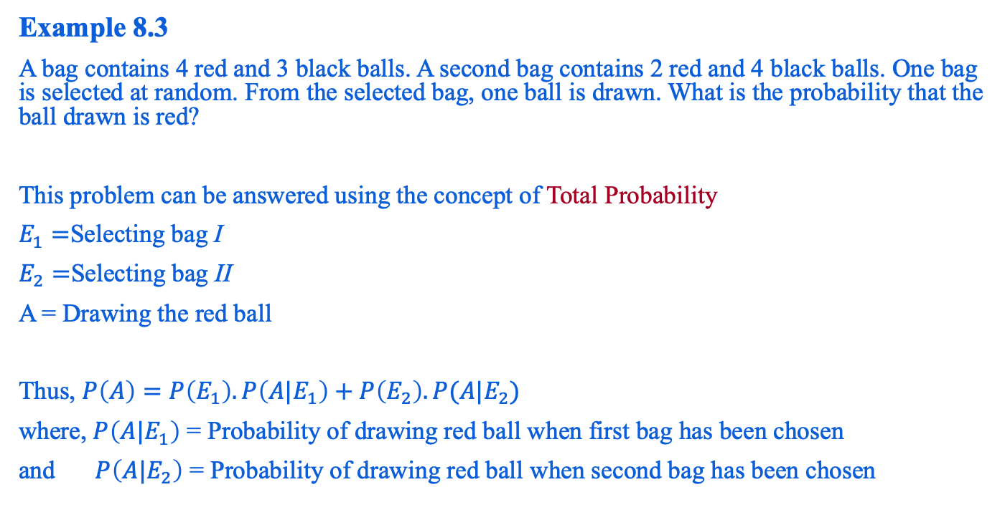
Total Probability: An Example
Example 8.3
A bag contains 4 red and 3 black balls. A second bag contains 2 red and 4 black balls. One bag is selected at random. From the selected bag, one ball is drawn. What is the probability that the ball drawn is red?
This problem can be answered using the concept of Total Probability
$E_{1}=$Selecting bag I
$E_{2}=$Selecting bag II
A = Drawing the red ball
Thus, $P\left(A\right)=P\left(E_{1}\right).P\left(A|E_{1}\right)+P\left(E_{2}\right).P(A|E_{2})$
where, $P\left(A|E_{1}\right)$ = Probability of drawing red ball when first bag has been chosen
and $P\left(A|E_{2}\right)$ = Probability of drawing red ball when second bag has been chosen

Slide 33
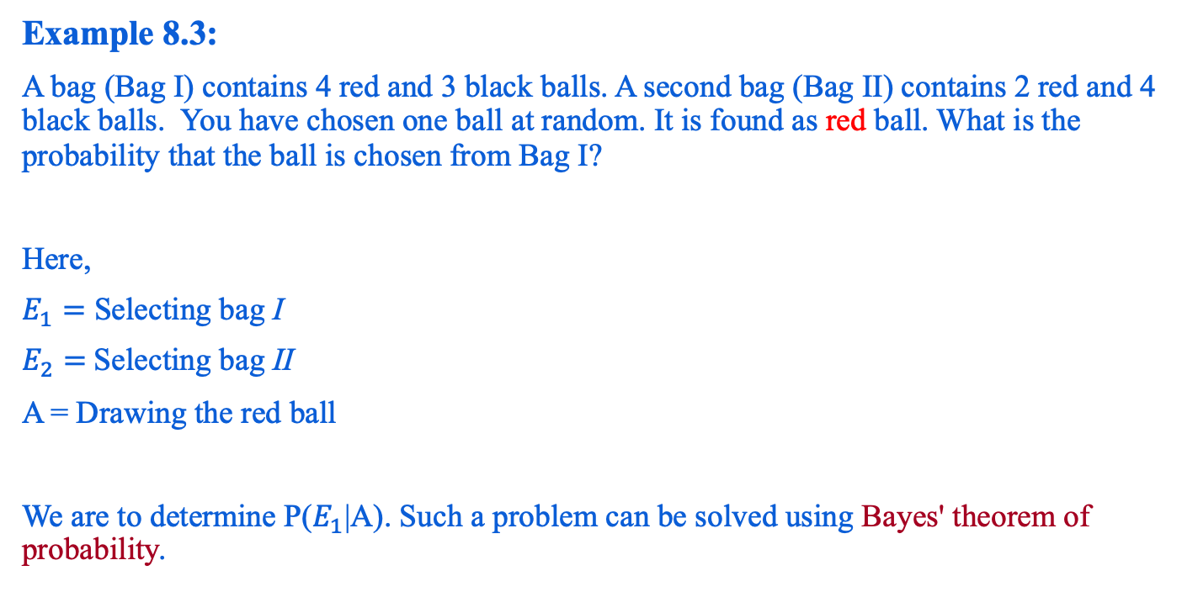
Reverse Probability
Example 8.3:
A bag (Bag I) contains 4 red and 3 black balls. A second bag (Bag II) contains 2 red and 4 black balls. You have chosen one ball at random. It is found as red ball. What is the probability that the ball is chosen from Bag I?
Here,
$E_{1}=$ Selecting bag I
$E_{2}=$Selecting bag II
A = Drawing the red ball
We are to determine P($E_{1}$|A). Such a problem can be solved using Bayes' theorem of probability.

Slide 34
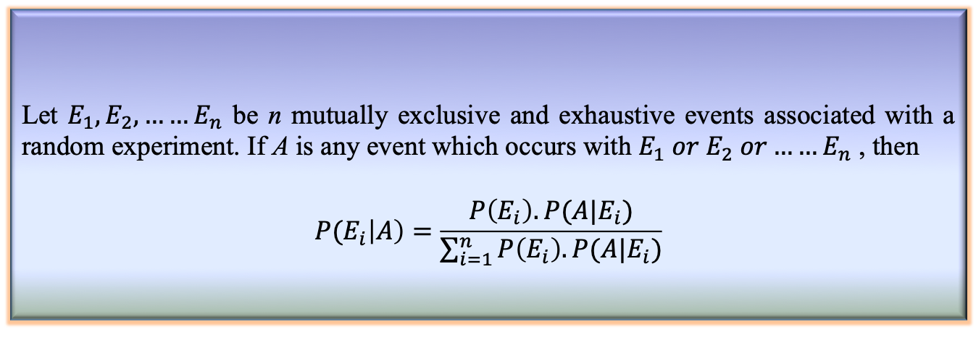
Bayes’ Theorem
Theorem 8.4: Bayes’ Theorem
Let $E_{1},E_{2},……E_{n}$ be n mutually exclusive and exhaustive events associated with a random experiment. If A is any event which occurs with $E_{1} or E_{2} or……E_{n}$ , then
$$P(E_{i}\left|A\right)=\frac{P\left(E_{i}\right).P(A|E_{i})}{\sum_{i=1}^{n}{P\left(E_{i}\right).P(A|E_{i})}}$$

Slide 35
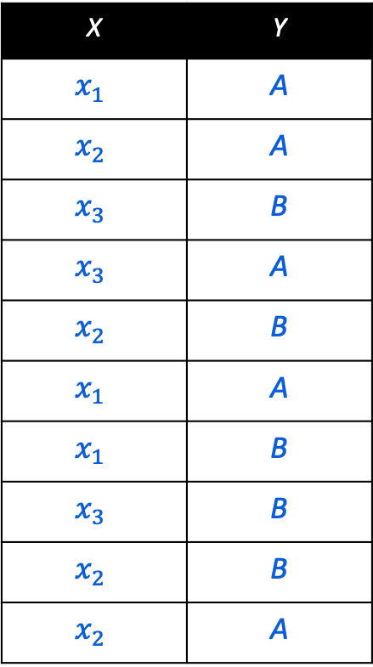
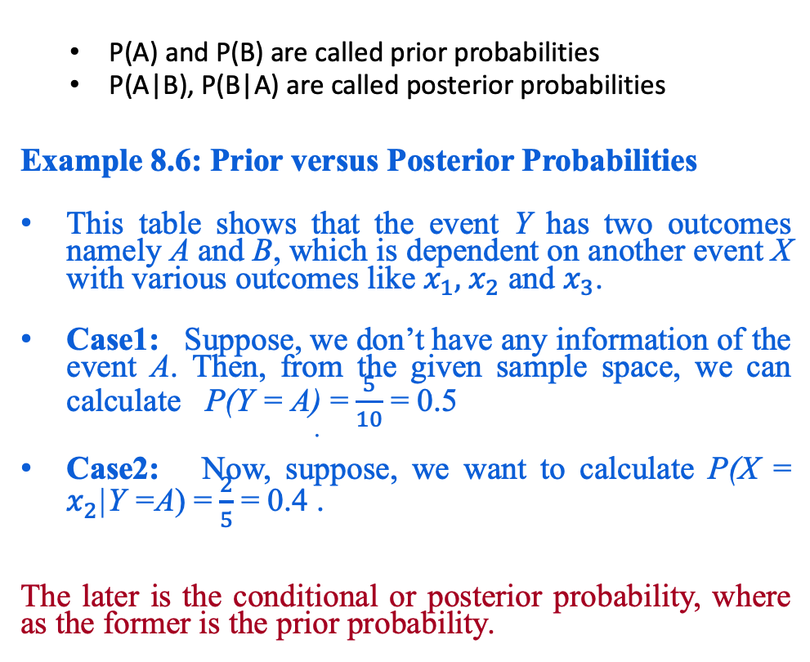
Prior and Posterior Probabilities
P(A) and P(B) are called prior probabilities
P(A|B), P(B|A) are called posterior probabilities
Example 8.6: Prior versus Posterior Probabilities
This table shows that the event Y has two outcomes namely A and B, which is dependent on another event X with various outcomes like $x_{1},{ x}_{2}$ and $x_{3}$.
Case1: Suppose, we don’t have any information of the event A. Then, from the given sample space, we can calculate P(Y = A) =$\frac{5}{10}$ = 0.5
Case2: Now, suppose, we want to calculate P(X = $x_{2}$|Y =A) =$\frac{2}{5}$ = 0.4 .
The later is the conditional or posterior probability, where as the former is the prior probability.
X | Y
$$x_{1}$$ | A
$$x_{2}$$ | A
$$x_{3}$$ | B
$$x_{3}$$ | A
$$x_{2}$$ | B
$$x_{1}$$ | A
$$x_{1}$$ | B
$$x_{3}$$ | B
$$x_{2}$$ | B
$$x_{2}$$ | A

Slide 36
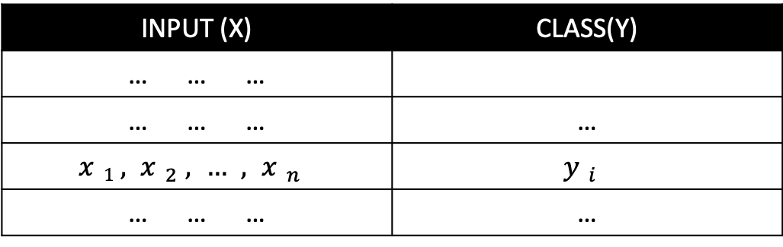
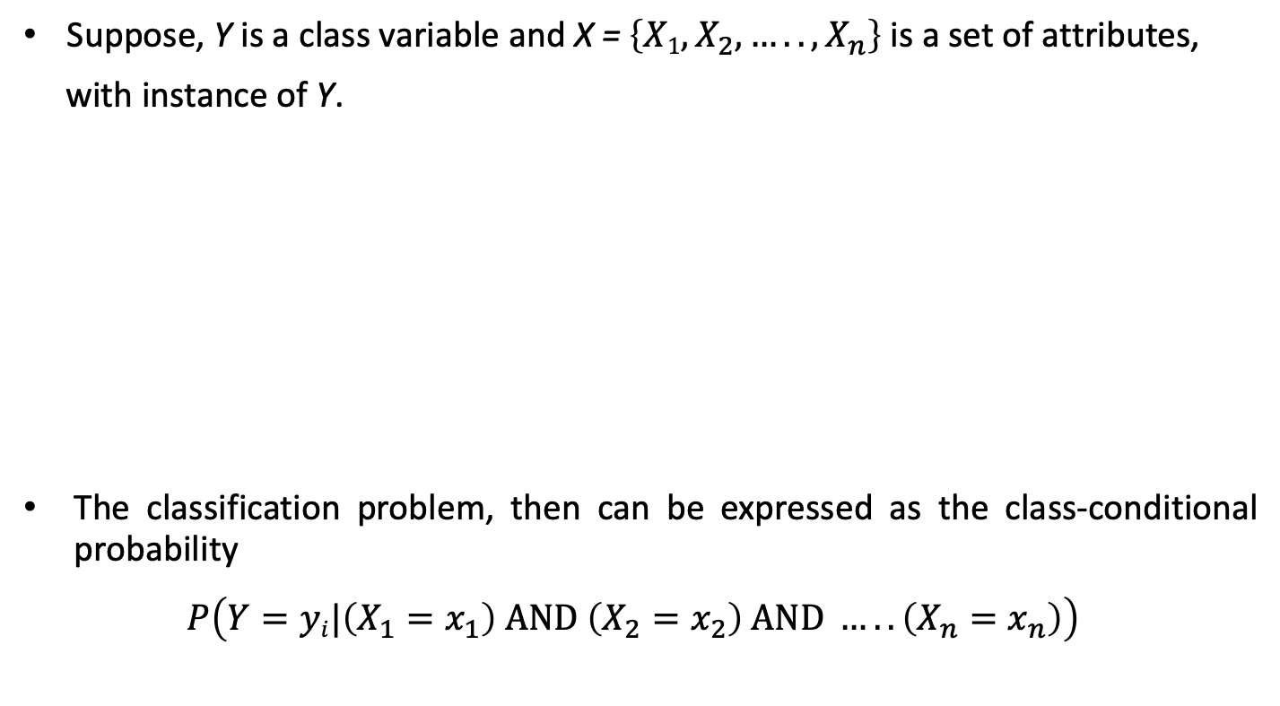
Naïve Bayesian Classifier
Suppose, Y is a class variable and X = $\left\{X1,X_{2},…..,X_{n}\right\}$ is a set of attributes,
with instance of Y.
The classification problem, then can be expressed as the class-conditional probability
$$P\left(Y=yi|\left(X_{1}=x_{1}\right) AND \left(X_{2}=x_{2}\right) AND …..\left(X_{n}=x_{n}\right)\right)$$
INPUT (X) | CLASS(Y)
… … …
… … … | …
$$x1,x_{2},…,x_{n}$$ | $$y_{i}$$
… … … | …

Slide 37
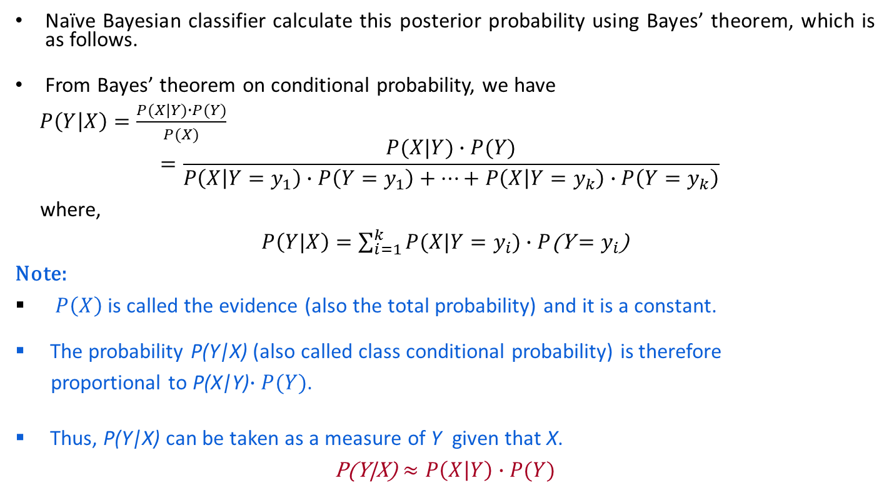
Naïve Bayesian Classifier
Naïve Bayesian classifier calculate this posterior probability using Bayes’ theorem, which is as follows.
From Bayes’ theorem on conditional probability, we have
$P\left(Y | X\right)=\frac{P(X|Y)∙P(Y)}{P(X)}$
$$=\frac{P(X|Y)∙P(Y)}{P\left(X | Y=y_{1}\right)∙P\left(Y=y_{1}\right)+…+P\left(X | Y=y_{k}\right)∙P\left(Y=y_{k}\right)}$$
where,
$P\left(Y|X\right)=\sum_{i=1}^{k}{P(X|Y=y_{i}})∙P$(Y$=y_{i}$)
Note:
$P\left(X\right)$ is called the evidence (also the total probability) and it is a constant.
The probability P(Y|X) (also called class conditional probability) is therefore
proportional to P(X|Y)$∙P(Y)$.
Thus, P(Y|X) can be taken as a measure of Y given that X.
P(Y|X) $≈P\left(X | Y\right)∙P(Y)$

Slide 38
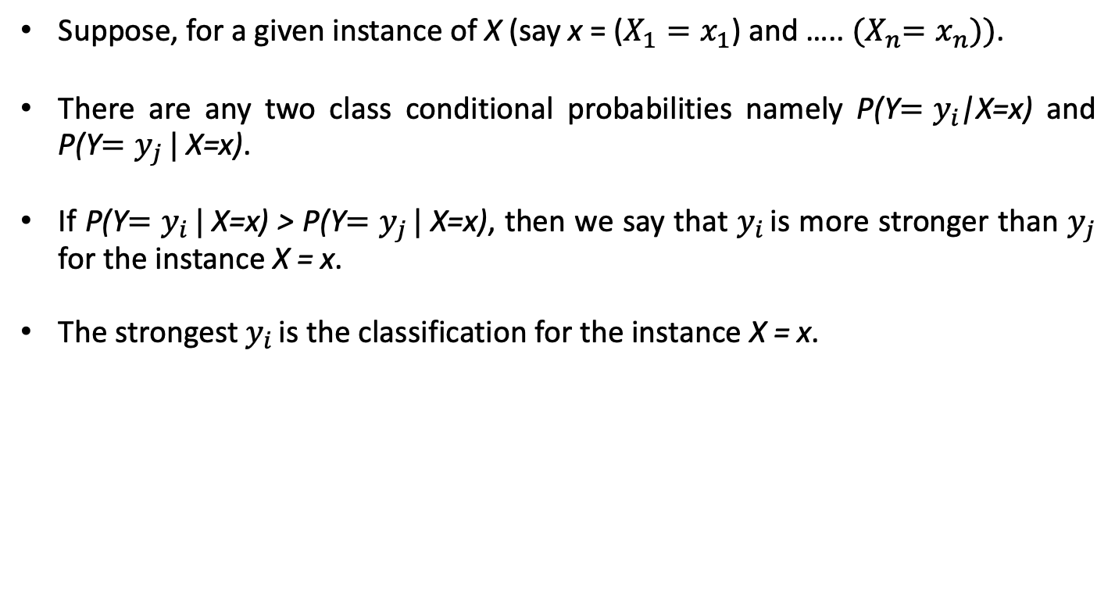
Naïve Bayesian Classifier
Suppose, for a given instance of X (say x = ($X_{1}=x_{1}$) and ….. ${(X}_{n}=x_{n}))$.
There are any two class conditional probabilities namely P(Y$=y_{i}$|X=x) and P(Y$=y_{j }|$X=x).
If P(Y$=y_{i }|$X=x) > P(Y$=y_{j }|$X=x), then we say that $y_{i }$is more stronger than $y_{j}$ for the instance X = x.
The strongest $y_{i }$is the classification for the instance X = x.

Slide 39
Naïve Bayesian Classifier
Example: With reference to the Air Traffic Dataset mentioned earlier, let us tabulate all the posterior and prior probabilities as shown below.
 |  | Class
Attribute |  | On Time | Late | Very Late | Cancelled
Day | Weekday | 9/14 = 0.64 | ½ = 0.5 | 3/3 = 1 | 0/1 = 0
 | Saturday | 2/14 = 0.14 | ½ = 0.5 | 0/3 = 0 | 1/1 = 1
 | Sunday | 1/14 = 0.07 | 0/2 = 0 | 0/3 = 0 | 0/1 = 0
 | Holiday | 2/14 = 0.14 | 0/2 = 0 | 0/3 = 0 | 0/1 = 0
Season | Spring | 4/14 = 0.29 | 0/2 = 0 | 0/3 = 0 | 0/1 = 0
 | Summer | 6/14 = 0.43 | 0/2 = 0 | 0/3 = 0 | 0/1 = 0
 | Autumn | 2/14 = 0.14 | 0/2 = 0 | 1/3= 0.33 | 0/1 = 0
 | Winter | 2/14 = 0.14 | 2/2 = 1 | 2/3 = 0.67 | 0/1 = 0

Slide 40
Naïve Bayesian Classifier
 |  | Class
Attribute |  | On Time | Late | Very Late | Cancelled
Fog | None | 5/14 = 0.36 | 0/2 = 0 | 0/3 = 0 | 0/1 = 0
 | High | 4/14 = 0.29 | 1/2 = 0.5 | 1/3 = 0.33 | 1/1 = 1
 | Normal | 5/14 = 0.36 | 1/2 = 0.5 | 2/3 = 0.67 | 0/1 = 0
Rain | None | 5/14 = 0.36 | 1/2 = 0.5 | 1/3 = 0.33 | 0/1 = 0
 | Slight | 8/14 = 0.57 | 0/2 = 0 | 0/3 = 0 | 0/1 = 0
 | Heavy | 1/14 = 0.07 | 1/2 = 0.5 | 2/3 = 0.67 | 1/1 = 1
Prior Probability |  | 14/20 = 0.70 | 2/20 = 0.10 | 3/20 = 0.15 | 1/20 = 0.05

Slide 41
Naïve Bayesian Classifier
Instance:
Case1: Class = On Time : 0.70 × 0.64 × 0.14 × 0.29 × 0.07 = 0.0013
Case2: Class = Late : 0.10 × 0.50 × 1.0 × 0.50 × 0.50 = 0.0125
Case3: Class = Very Late : 0.15 × 1.0 × 0.67 × 0.33 × 0.67 = 0.0222
Case4: Class = Cancelled : 0.05 × 0.0 × 0.0 × 1.0 × 1.0 = 0.0000
Case3 is the strongest; Hence correct classification is Very Late
Week Day | Winter | High | Heavy | ???

Slide 42
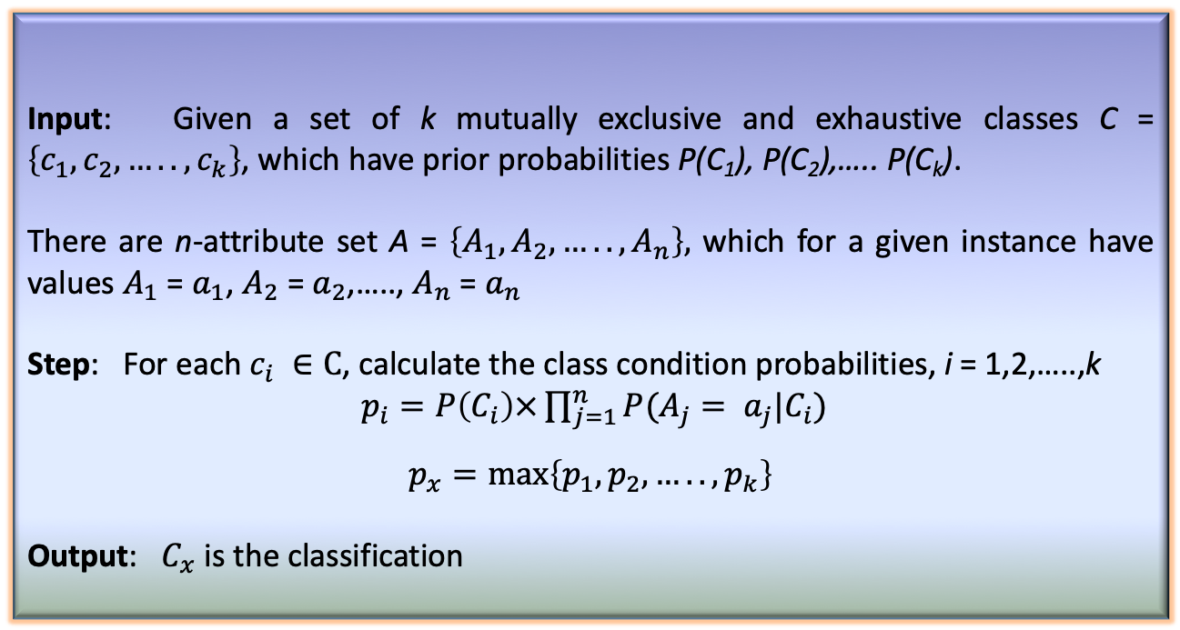
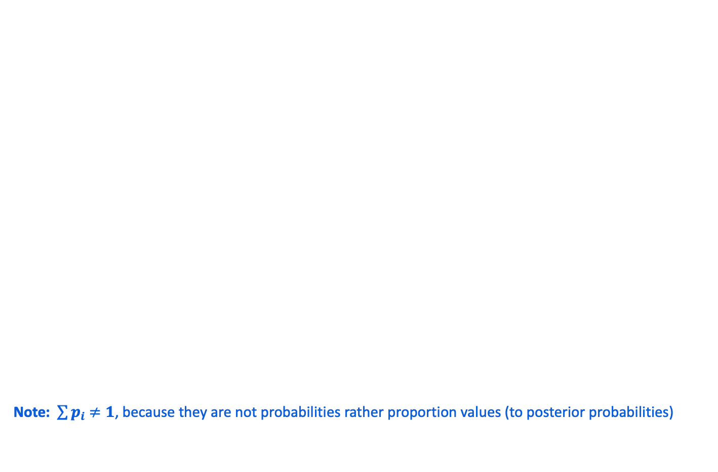
Naïve Bayesian Classifier
Input: Given a set of k mutually exclusive and exhaustive classes C = $\left\{c_{1},c_{2},…..,c_{k}\right\}$, which have prior probabilities P(C₁), P(C₂),….. P(C_{k}).
There are n-attribute set A = $\left\{A_{1},A_{2},…..,A_{n}\right\},$ which for a given instance have values $A_{1}$ = $a_{1}$, $A_{2}$ = $a_{2}$,….., $A_{n}$ = $a_{n}$
Step: For each $c_{i} ∈C$, calculate the class condition probabilities, i = 1,2,…..,k
$p_{i}=P\left(C_{i}\right)\text{×}\prod_{j=1}^{n}{P(A_{j}= a_{j}|C_{i}})$
$$p_{x}=\max\left\{p_{1},p_{2},…..,p_{k}\right\}$$
Output: $C_{x}$ is the classification
Algorithm: Naïve Bayesian Classification
Note: $\sum{p_{i}}$ $≠1$, because they are not probabilities rather proportion values (to posterior probabilities)

Slide 43
Naïve Bayesian Classifier
Pros and Cons
The Naïve Bayes’ approach is a very popular one, which often works well.
However, it has a number of potential problems
It relies on all attributes being categorical.
If the data is less, then it estimates poorly.

Slide 44
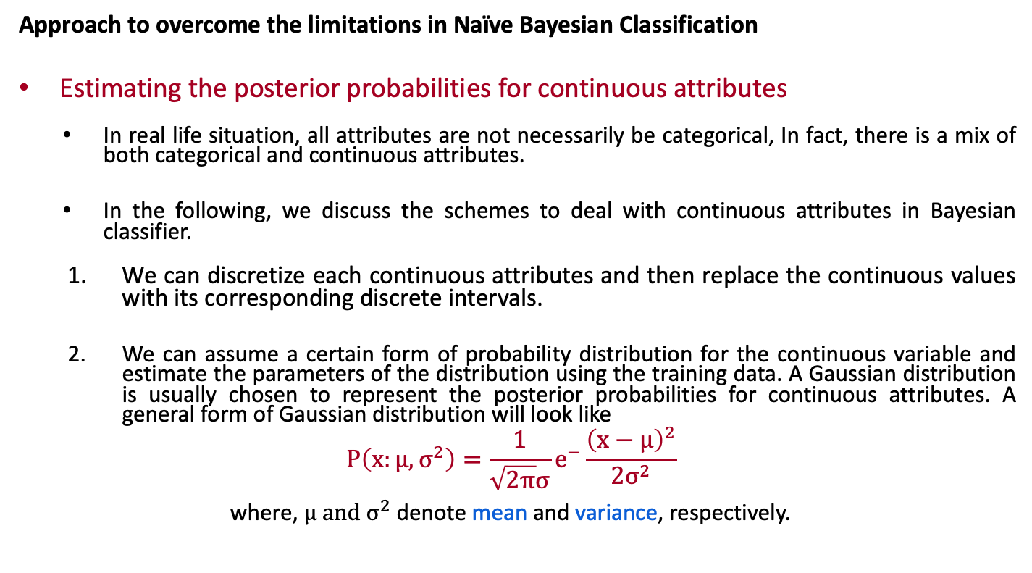
Naïve Bayesian Classifier
Approach to overcome the limitations in Naïve Bayesian Classification
Estimating the posterior probabilities for continuous attributes
In real life situation, all attributes are not necessarily be categorical, In fact, there is a mix of both categorical and continuous attributes.
In the following, we discuss the schemes to deal with continuous attributes in Bayesian classifier.
We can discretize each continuous attributes and then replace the continuous values with its corresponding discrete intervals.
We can assume a certain form of probability distribution for the continuous variable and estimate the parameters of the distribution using the training data. A Gaussian distribution is usually chosen to represent the posterior probabilities for continuous attributes. A general form of Gaussian distribution will look like
$$P\left(x:μ,σ^{2}\right)=\frac{1}{\sqrt{2π}σ}e^{−}\frac{{\left(x−μ\right)}^{2}}{2σ^{2}}$$
where, $μ and σ^{2}$ denote mean and variance, respectively.

Slide 45
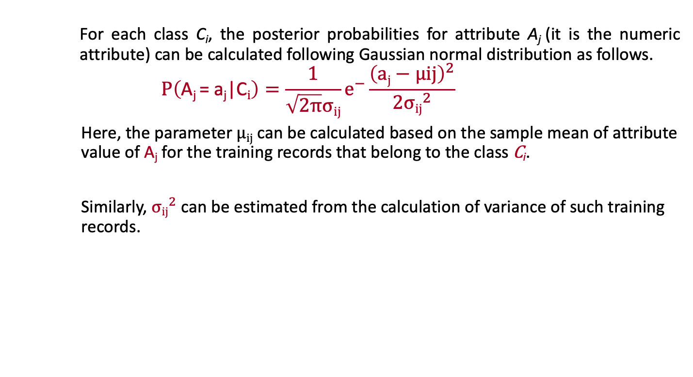
Naïve Bayesian Classifier
For each class C_{i}, the posterior probabilities for attribute A_{j} (it is the numeric attribute) can be calculated following Gaussian normal distribution as follows.
$$P\left(\text{A}\text{j}\text{ = }\text{aj}\text{|}\text{C}i\right)=\frac{1}{\sqrt{2π}σij}e^{−}\frac{{\left(aj−μij\right)}^{2}}{2{σij}^{2}}$$
Here, the parameter $μij$ can be calculated based on the sample mean of attribute value of $\text{A}\text{j}$ for the training records that belong to the class $\text{C}\text{i}$.
Similarly, ${σij}^{2}$ can be estimated from the calculation of variance of such training records.

Slide 46
Naïve Bayesian Classifier
M-estimate of Conditional Probability
The M-estimation is to deal with the potential problem of Naïve Bayesian Classifier when training data size is too poor.
If the posterior probability for one of the attribute is zero, then the overall class-conditional probability for the class vanishes.
In other words, if training data do not cover many of the attribute values, then we may not be able to classify some of the test records.
This problem can be addressed by using the M-estimate approach.

Slide 47
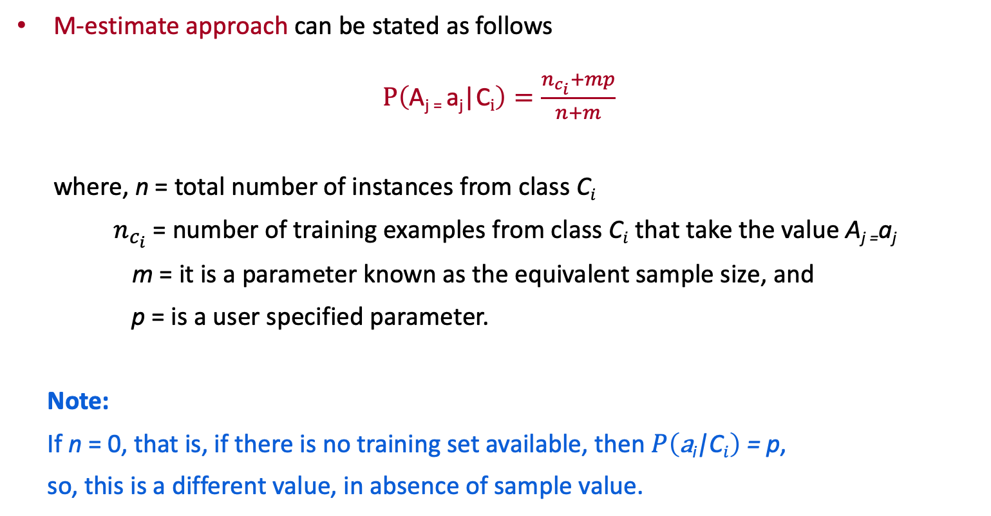
M-estimate Approach
M-estimate approach can be stated as follows
$P\left(\text{A}\text{j}\text{ = }\text{a}\text{j}\text{|}\text{C}i\right)=\frac{n_{c_{i}}+mp}{n+m}$
where, n = total number of instances from class $\text{C}i$
$n_{c_{i}}$ = number of training examples from class $\text{C}i$ that take the value $\text{A}\text{j}\text{ =}\text{a}\text{j}$
m = it is a parameter known as the equivalent sample size, and
p = is a user specified parameter.
Note:
If n = 0, that is, if there is no training set available, then $P\left(\text{a}\text{i}\text{|}\text{C}i\right)$ = p,
so, this is a different value, in absence of sample value.

Slide 48
A Practice Example
Example 8.4
Class:
C1:buys_computer = ‘yes’
C2:buys_computer = ‘no’
Data instance
X = (age <=30,
Income = medium,
Student = yes
Credit_rating = fair)

Slide 49
A Practice Example
P(C_{i}): P(buys_computer = “yes”) = 9/14 = 0.643
P(buys_computer = “no”) = 5/14= 0.357
Compute P(X|C_{i}) for each class
P(age = “<=30” | buys_computer = “yes”) = 2/9 = 0.222
P(age = “<= 30” | buys_computer = “no”) = 3/5 = 0.6
P(income = “medium” | buys_computer = “yes”) = 4/9 = 0.444
P(income = “medium” | buys_computer = “no”) = 2/5 = 0.4
P(student = “yes” | buys_computer = “yes) = 6/9 = 0.667
P(student = “yes” | buys_computer = “no”) = 1/5 = 0.2
P(credit_rating = “fair” | buys_computer = “yes”) = 6/9 = 0.667
P(credit_rating = “fair” | buys_computer = “no”) = 2/5 = 0.4
X = (age <= 30 , income = medium, student = yes, credit_rating = fair)
P(X|C_{i}) : P(X|buys_computer = “yes”) = 0.222 × 0.444 × 0.667 × 0.667 = 0.044
P(X|buys_computer = “no”) = 0.6 × 0.4 × 0.2 × 0.4 = 0.019
P(X|C_{i})*P(C_{i}) : P(X|buys_computer = “yes”) * P(buys_computer = “yes”) = 0.028
P(X|buys_computer = “no”) * P(buys_computer = “no”) = 0.007
Therefore, X belongs to class (“buys_computer = yes”)

Slide 50
Thank You!

